Slide 1
CISC320 Algorithms
Recursion
Austin Cory Bart AlgoTutorBot University of Delaware
Notes:
Bart: Hey everyone, it’s Dr. Bart. I’m still stuck down in this underground facility
Bart: This thing is so ridiculously massive. Take a look.

Slide 2
Recursion
Definition
a process in which the result of each repetition is dependent upon the result of the next repetition.
If you still don't understand, go see the definition of Recursion
Hofstadter's Law
“It always takes longer than you expect, even when you take into account Hofstadter's Law.”
Sesquipedalian
A person who uses words like sesquipedalian.
Yogi Berra
“Its déjà vu all over again.”

Slide 3
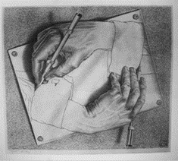
Art
MC Escher

Slide 4
What Is Recursion?
Consider hiring a contractor to build something
He hires a subcontractor for a portion of the job
That subcontractor hires a sub-subcontractor to do a smaller portion of job
The last sub-sub- … subcontractor finishes
Each one finishes and reports “done” up the line

Slide 5
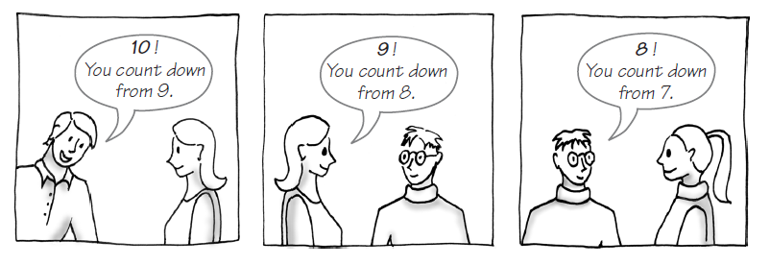
Example: The Countdown
FIGURE 7-1 Counting down from 10

Slide 6
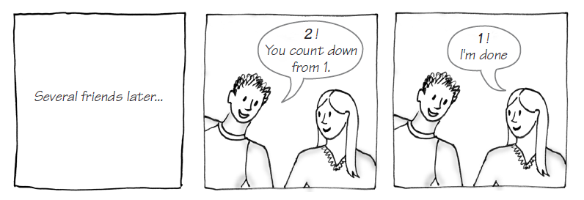
Example: The Countdown
FIGURE 7-1 Counting down from 10

Slide 7
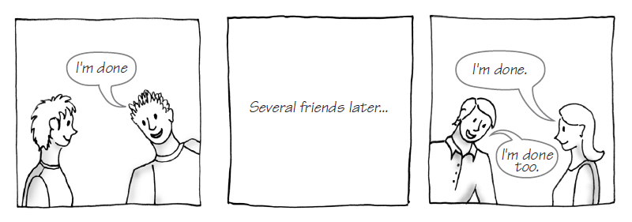
Example: The Countdown
FIGURE 7-1 Counting down from 10

Slide 8
Recursion in Python
def count_down(value):
print(value)
if value == 0:
return "I'm done"
else:
return count_down(value-1)
The function calls itself!

Slide 9
Definition
Recursion is a problem-solving process
Breaks a problem into identical but smaller subproblems.
A function that calls itself is a recursive function.
The invocation is a recursive call or recursive invocation.

Slide 10
Design Guidelines
Function must take parameters
Function definition must contain logic involving the parameters, leading to different cases
Base Case: One or more cases should provide solution that does not require recursion
Else infinite recursion
Recursive Case: One or more cases must include a recursive invocation
Notes:
Need a base case
Need a recrusive case that gets closer to the base case

Slide 11
Basic Recursion Steps
Put an IF/ELSE statement in your code
Handle the "Base Case"
Handle the Recursive Case
Modify the input
Call the recursive method
Do something with the result

Slide 12
Recursion Template
def function_name(parameter):
if ____:
...
else:
reduced = ... parameter ...
result = function_name(... reduced ...)
... result
1. The "simplest case"
2. Need to reduce parameter
3. Need to call function with reduced data
4. Need to do something with result

Slide 13
Base Case
What do when
The number is zero
The string is empty
The list is empty
The dictionary is empty
…
Usually…
Return zero, an empty string, an empty list, etc.

Slide 14
Recursive Case
Reduce: Break off a piece
Recurse: Call the recursive method on the rest
Result: Combine the results

Slide 15
Why recursion?
Anything you can do with a WHILE or FOR loop, you can do with recursion
And vice versa
Some people find recursion more natural, some people prefer WHILE/FOR loops
Some problems are very easy to express with recursion

Slide 16
Examples

Slide 17
Fibonacci
The nth Fibonacci number is the sum of the two previous Fibonacci numbers
Fib(1) is 1
Fib(2) is 1
Fib(n) = Fib(n-1) + Fib(n-2)

Slide 18
Sum a list
A list can be seen as recursive
A list is either:
EMPTY
A first element and the rest
First = List[0]
Rest = List[1:]
Anything you can do with a for loop you can do with recursion

Slide 19
Process a tree
Person is a dictionary with the following keys:
"Name": string
"Wealth": integer
"Children": list of Person
How much money does a Person have if you include all their descendants?

Slide 20
Common Novice Mistakes
When using recursion

Slide 21
Forgot base case
You must have an IF statement, and one of the cases should handle the end result
If the integer is zero, return 0/False/empty string/etc
If the string is empty, return 0/False/empty string/etc
…

Slide 22
Forgot to reduce recursive case
In the recursive case, you must make something smaller!
Decrease the integer by 1
Remove the last character from the string
Remove the last element of a list
…

Slide 23
Forgot to recurse
If you didn't call the function somewhere inside of its definition, then you aren't using recursion

Slide 24
Forgot to use result
Did you remember to return your recursive result?

Slide 25
Tried to handle n+1+1 case instead of n+1
Students often try to think two steps ahead, instead of focusing on just the current case

